Slide 1

Good Morning!

Slide 2
Case Study Dairy
For testing in Graz

Slide 3
The dairy
Employes 100
Processes 200 t/d of milk to drinking milk, cheese, butter
Consumes 500 m³/d of water
Has approximately 2.5% milk losses
Has a waste water treatment plant
Uses R22

Slide 4
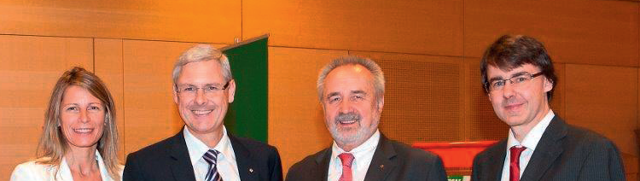
The management team

Slide 5

Awards
„cheese oskar“

Slide 6
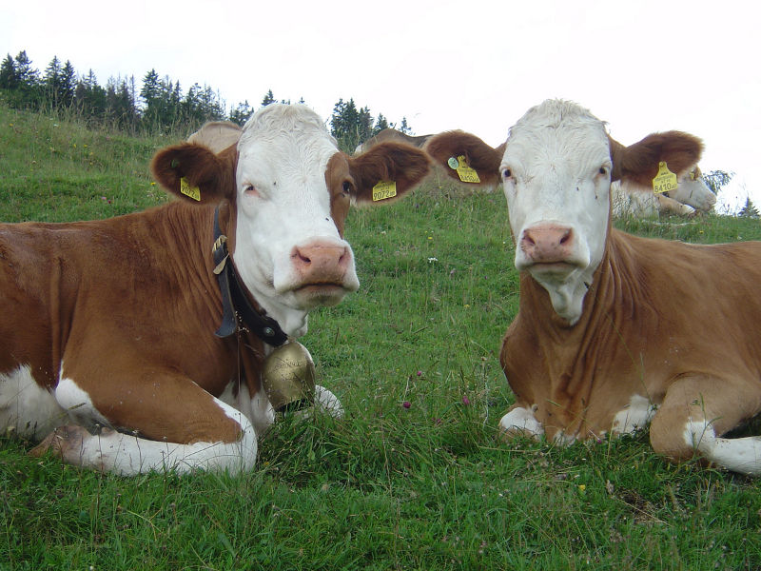
Happy cows

Slide 7
Organisational units
Management
Administration
Consulting farmers
Utilities (boiler, chiller)
Logistics
Production
Waste management

Slide 8
Products
Product |  |  | Annual quantity | unit
Cheese |  |  | 2000 | t
Hard cheese |  |  | 75,5 | %
Cut and packaged |  |  | 14,8 | %
Soft cheese |  |  | 9,6 | %
Milk |  |  | 30000 | t
conventional |  |  | 83,3 | %
bio |  |  | 11,5 | %
industrial |  |  | 5,6 | %
Butter |  |  | 1000 | t
Conventional |  |  | 82,1 | %
bio |  |  | 17,9 | %
1 ton of cheese requires about 10 tons of milk,
1 ton of butter about 20 tons of milk

Slide 9
Inputs
1 | Water | 247195 | m³
 | From well | 172627 | m³
 | From city | 74568 | m³
 | Waste water | 248009 | m³
2 | Raw milk | 60000 | t
3 | Cardboard | 21 | t
4 | Film | 40 | t
5 | Labels | 5 | t

Slide 10
Inputs
1 | Water |  | €/m³
 | From well | 0
 | From city | 1
 | Waste water | 1 | €/m³
2 | Raw milk | 0,25 | €/kg
3 | Cardboard | 3 | €/kg
4 | Film | 2 | €/kg
5 | Labels | 2 | €/kg

Slide 11
Hazardous materials
Nr. | MSDS | Material | Annual quantity | unit | label
1 | j | Cleaning agents | 7120 | kg | diverse
2 | j | Disinfectants | 15202 | kg | diverse
3 | j | lubricants | 647 | kg | diverse
4 | j | refrigerants | 110 | kg | diverse

Slide 12
Hazardous materials
Nr. | MSDS | Material |  | unit
1 | j | Cleaning agents | 2 | €/kg
2 | j | Disinfectants | 5 | €/kg
3 | j | lubricants | 2 | €/kg
4 | j | refrigerants | 12 | €/kg

Slide 13
Waste
Waste
 | ÖNORM S2100 | Annual quantity [kg]
Industrial waste | 91101 | 52.214
Wood pallets | 17201 | employees
Waste paper | 18718 | 21.420
Iron and steel scrap | 35105 | 7.660
Packaging material | 91207 | 16.220
Organic waste | 92402 | employees
whey | 12502 | 25.000.000

Slide 14
Energy
7 GWH electricity , 10 cents
30.000 l Diesel, 1,3 €/l
7 Mio sm³, 0,35€/sm³

Slide 15
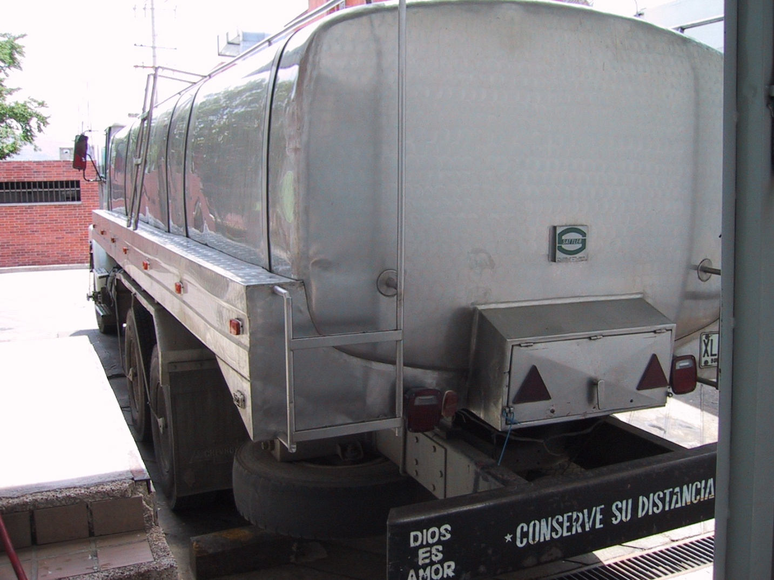
Reception of milk
Cleaning

Slide 16
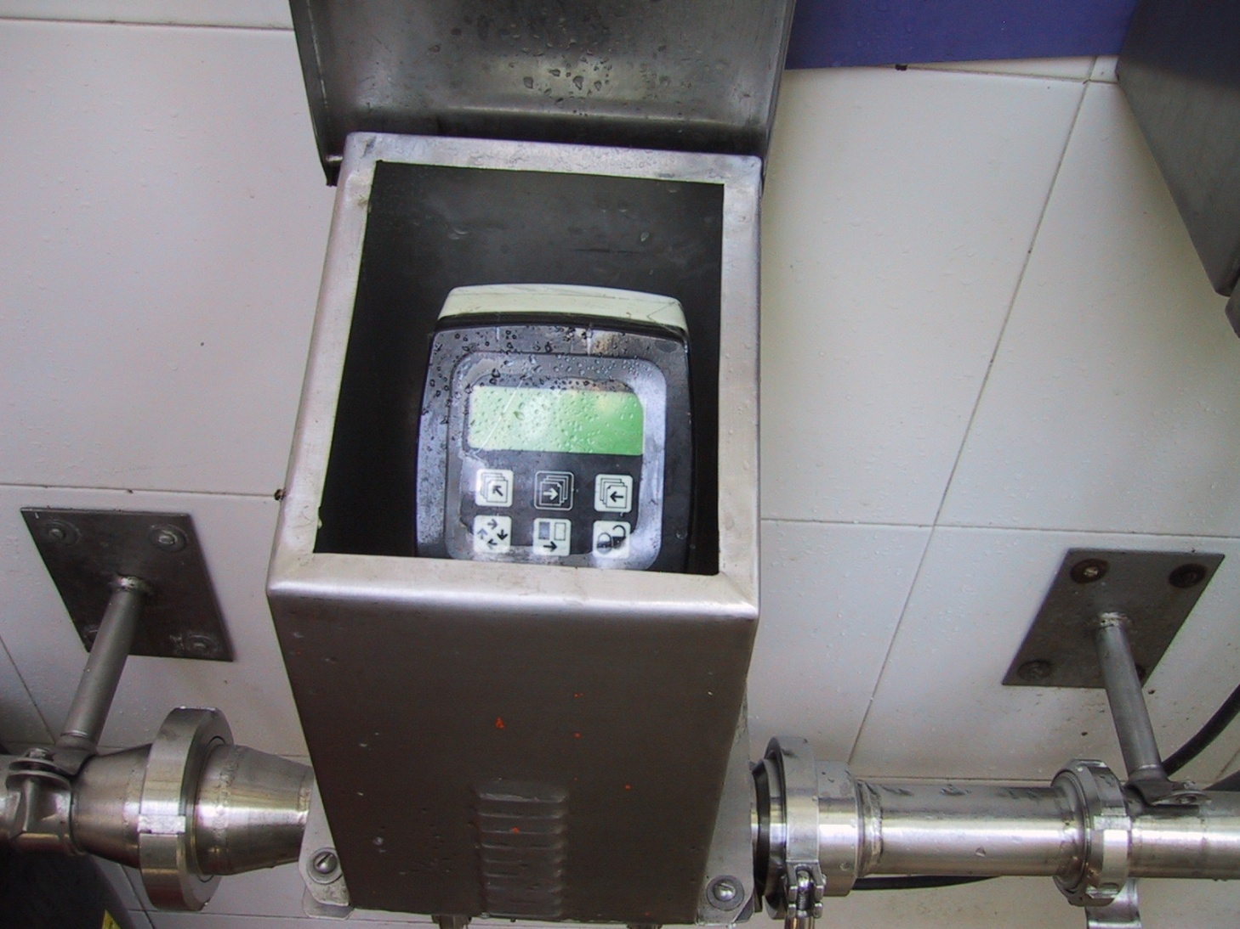
Metering

Slide 17
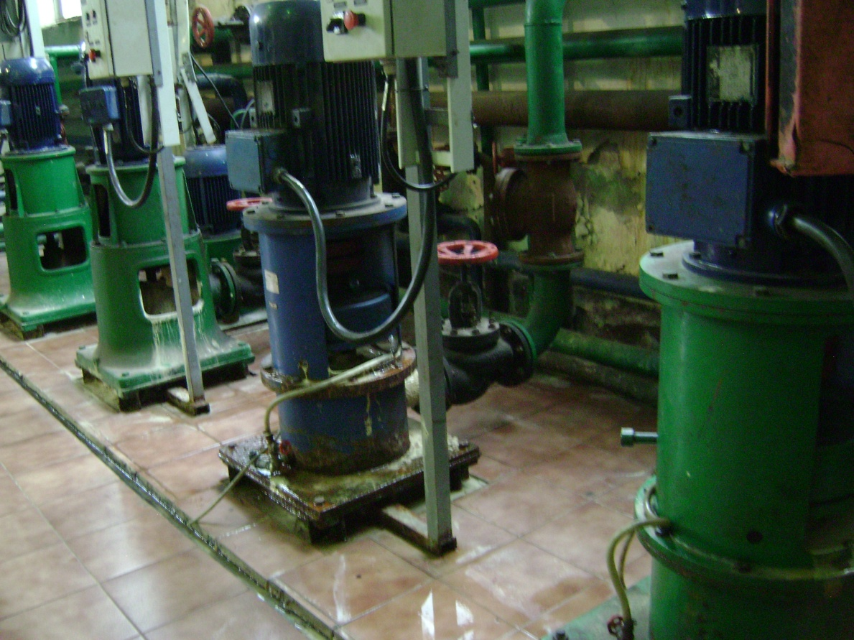
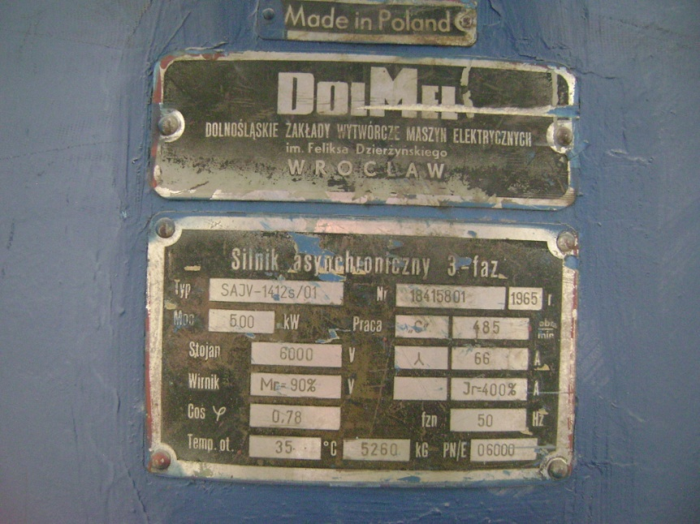
Pumps

Slide 18
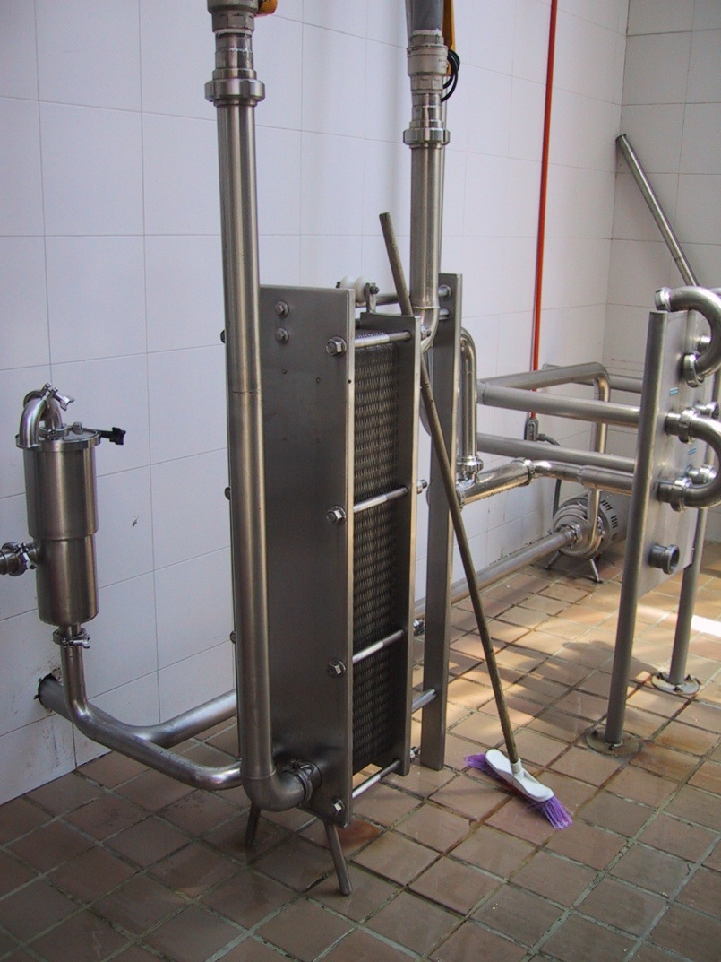
Cooling
Cleaning

Slide 19
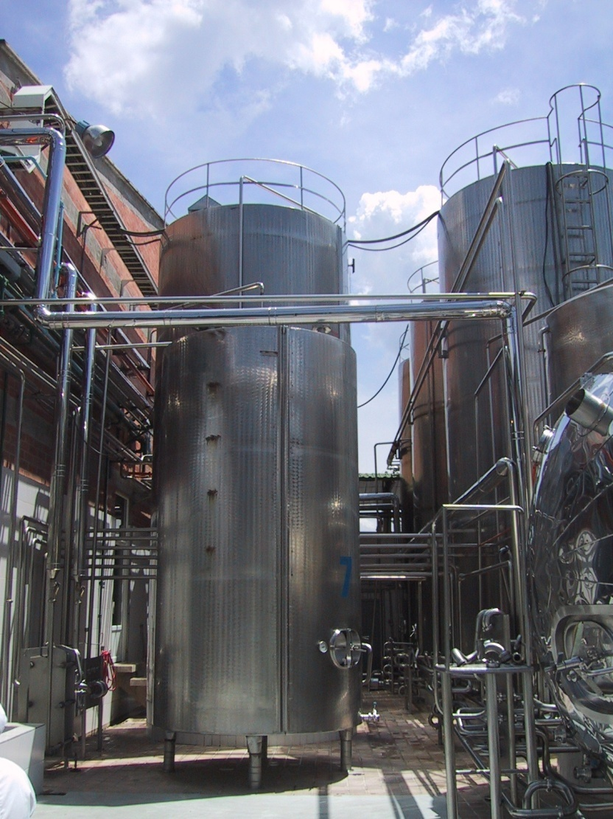
Storage
Cleaning

Slide 20
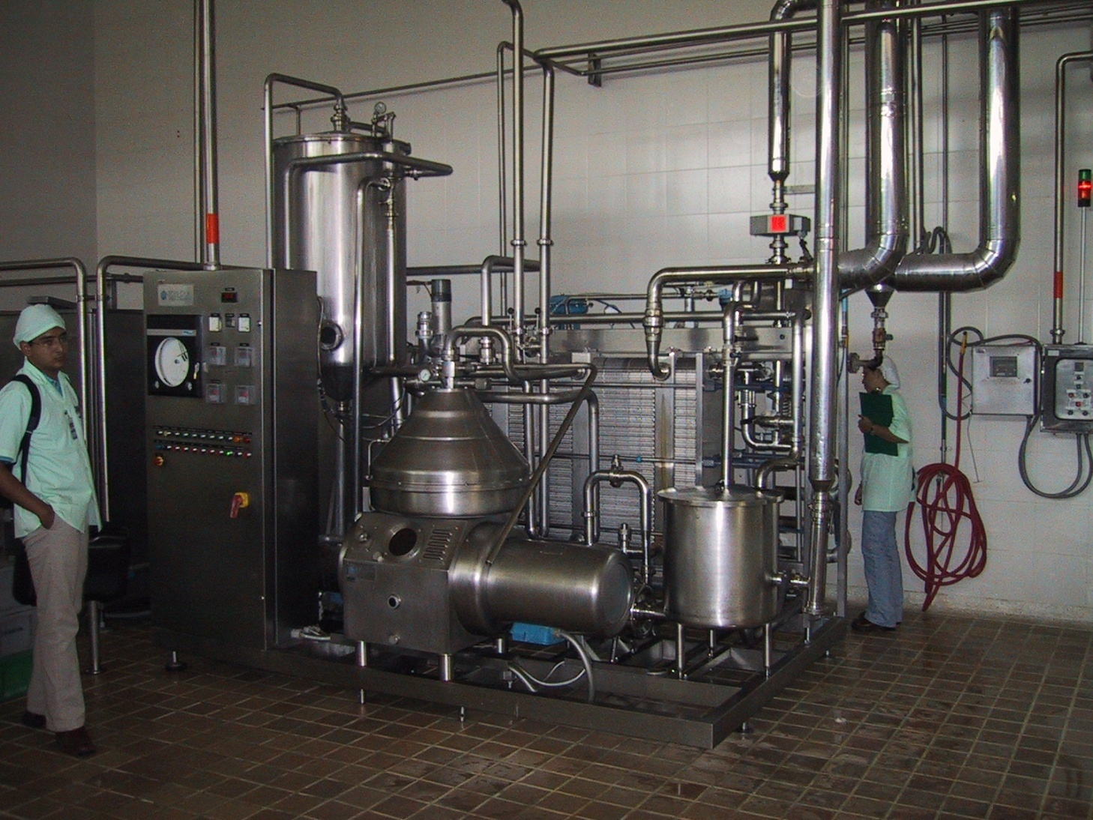
Pasteurization
Cleaning,
Cooling

Slide 21
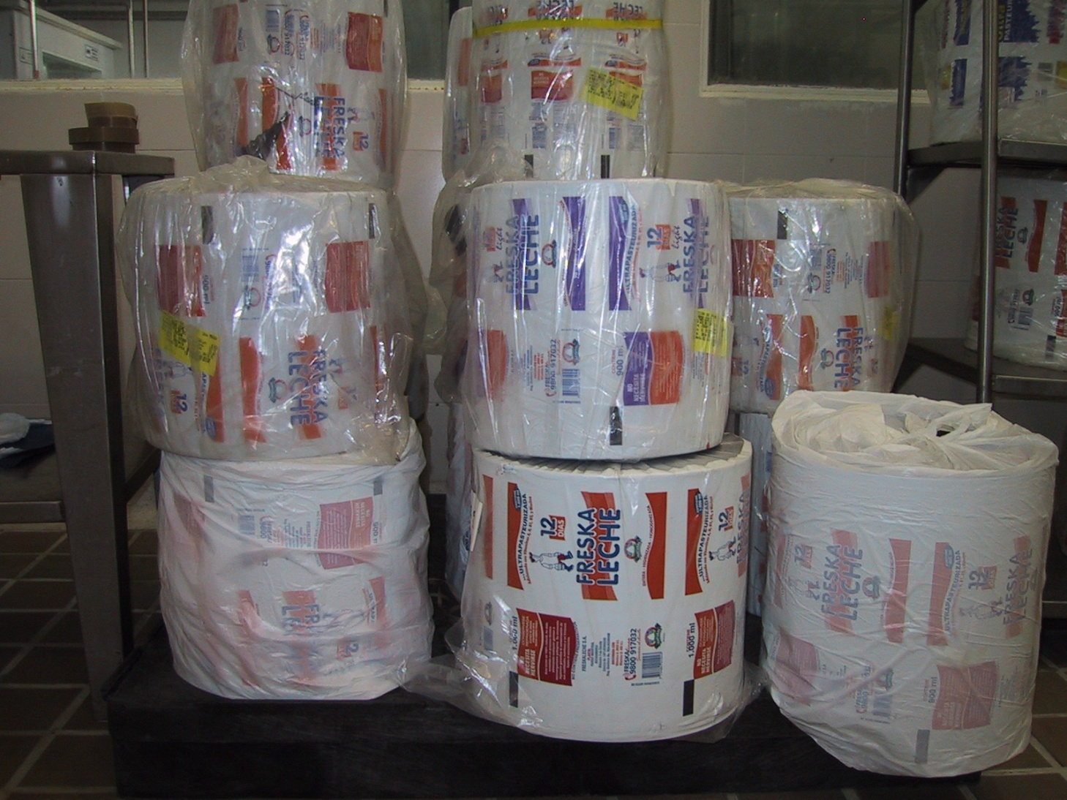
Packaging material

Slide 22
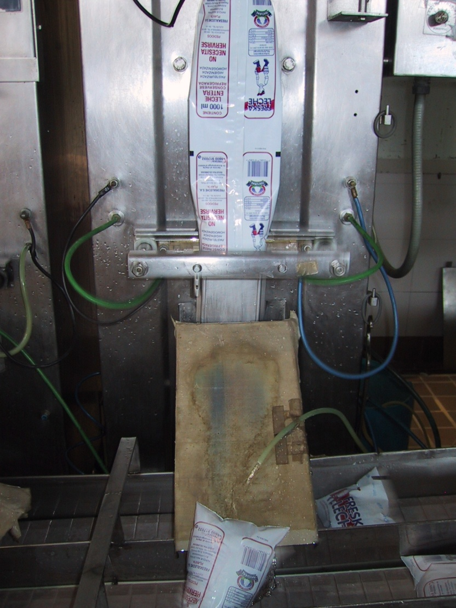
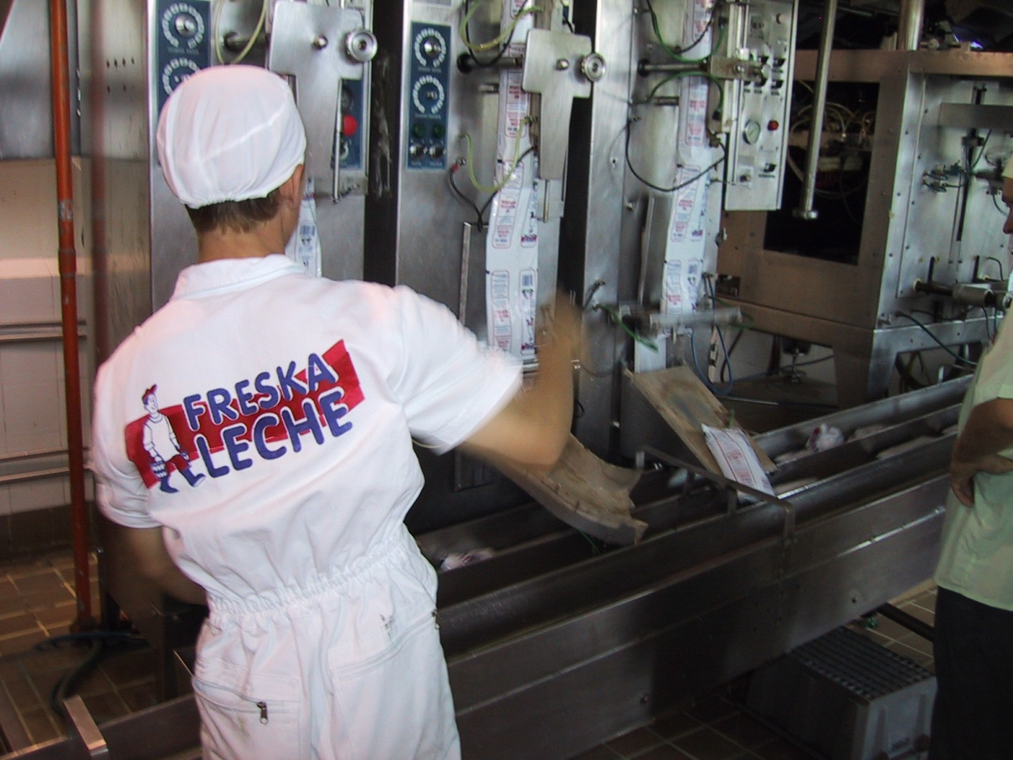
Filling
Cleaning, cooling,
Packaging waste

Slide 23
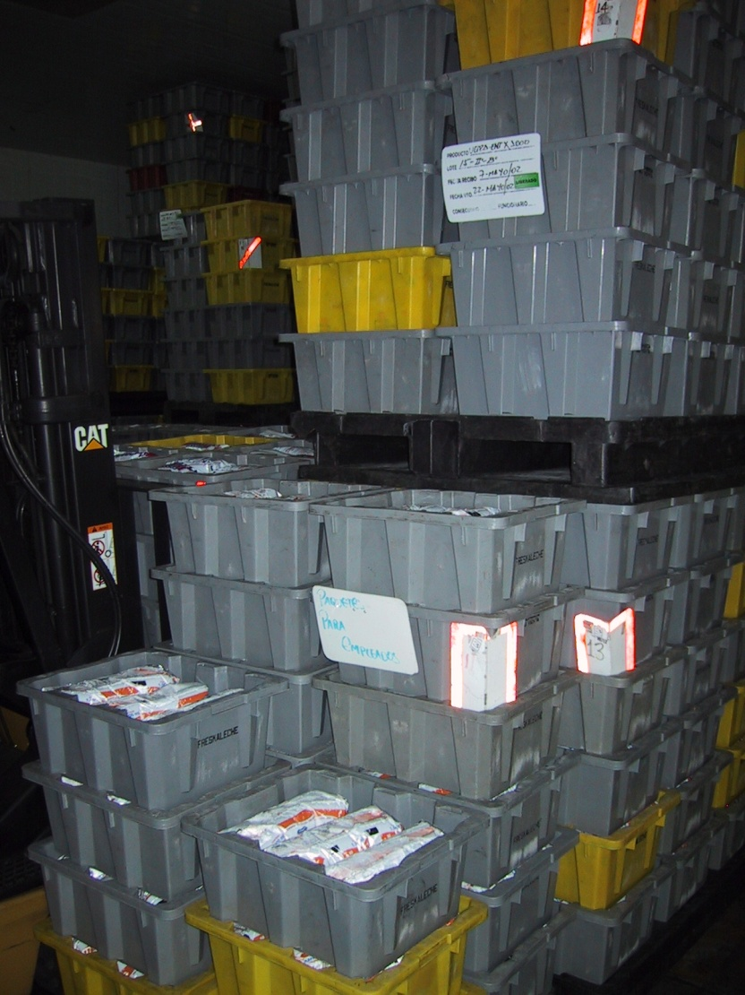
Ready made product

Slide 24
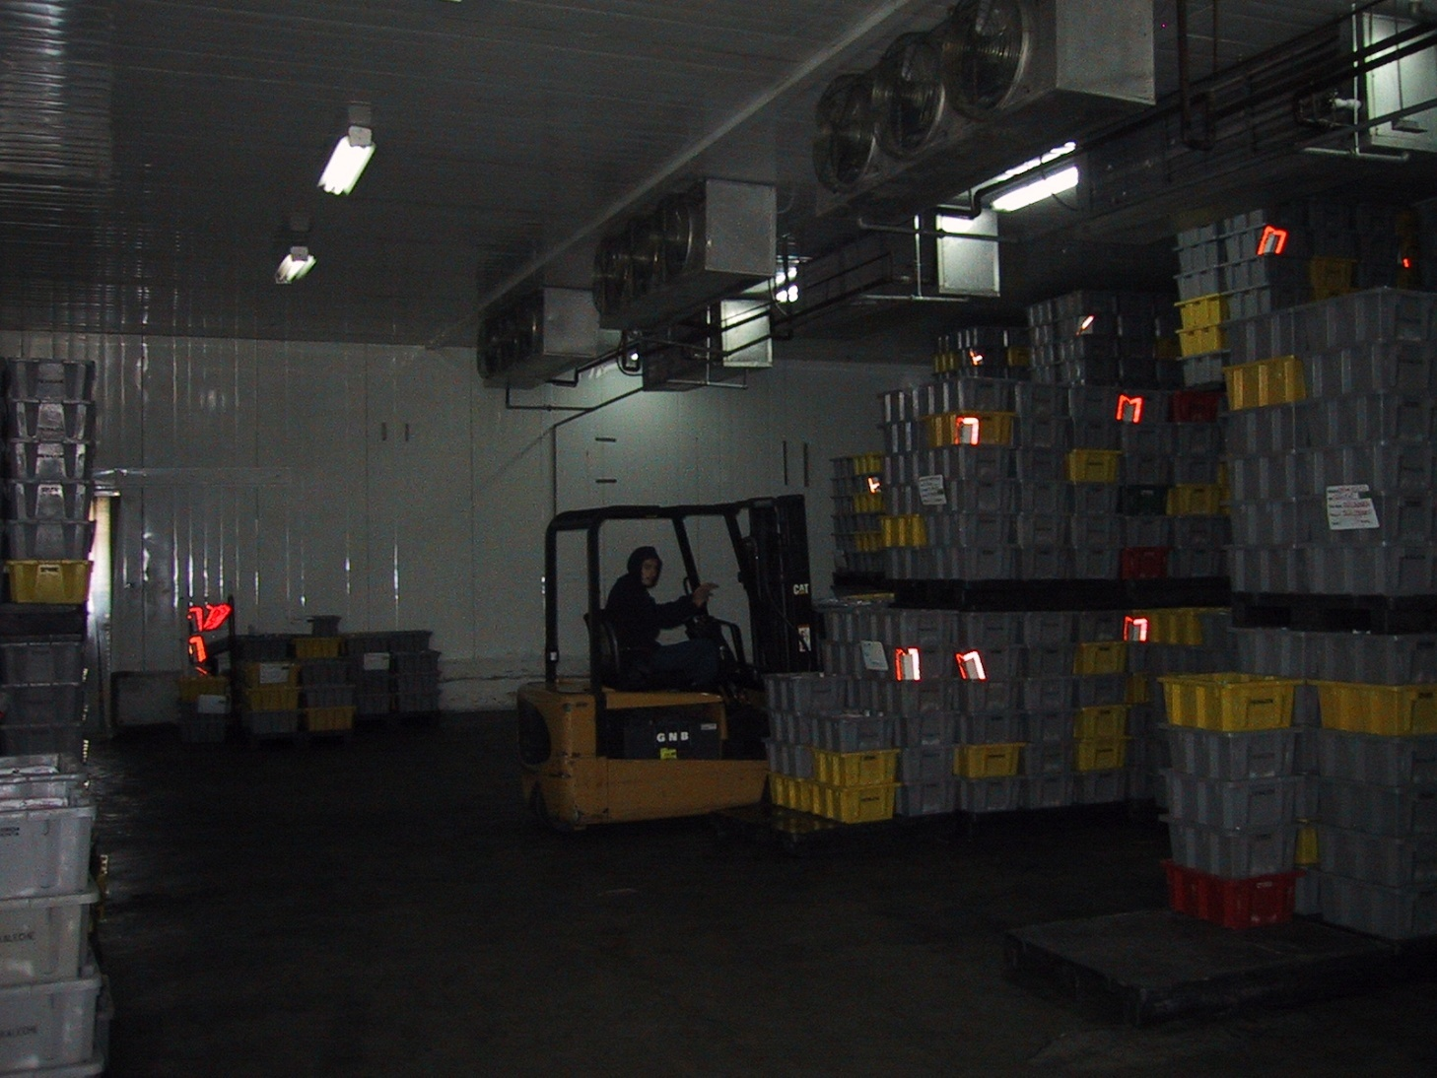
Storage

Slide 25
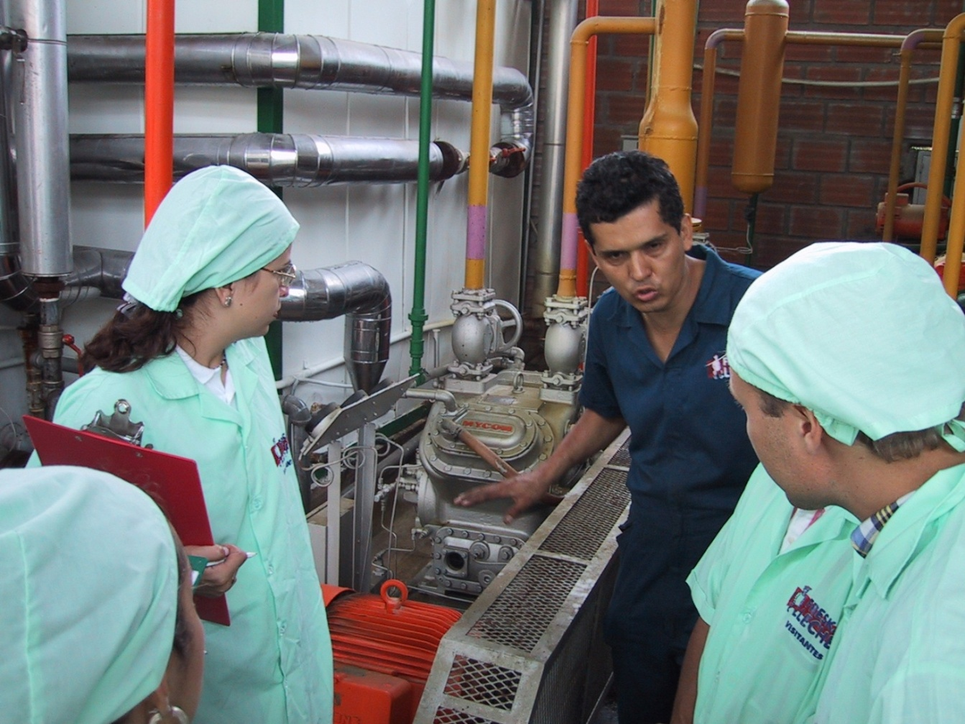
Cooling - Compressor

Slide 26
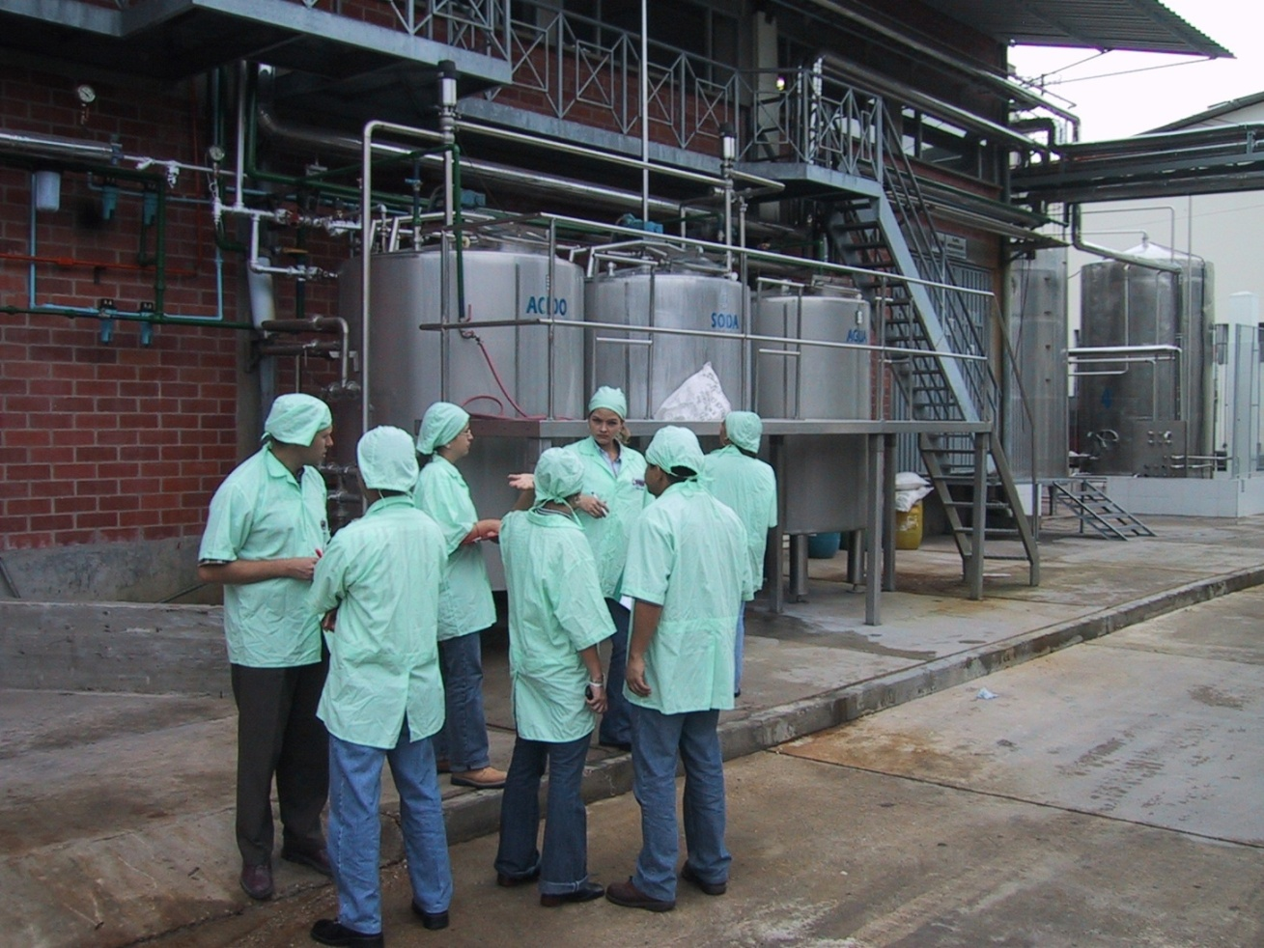
CIP plant

Slide 27
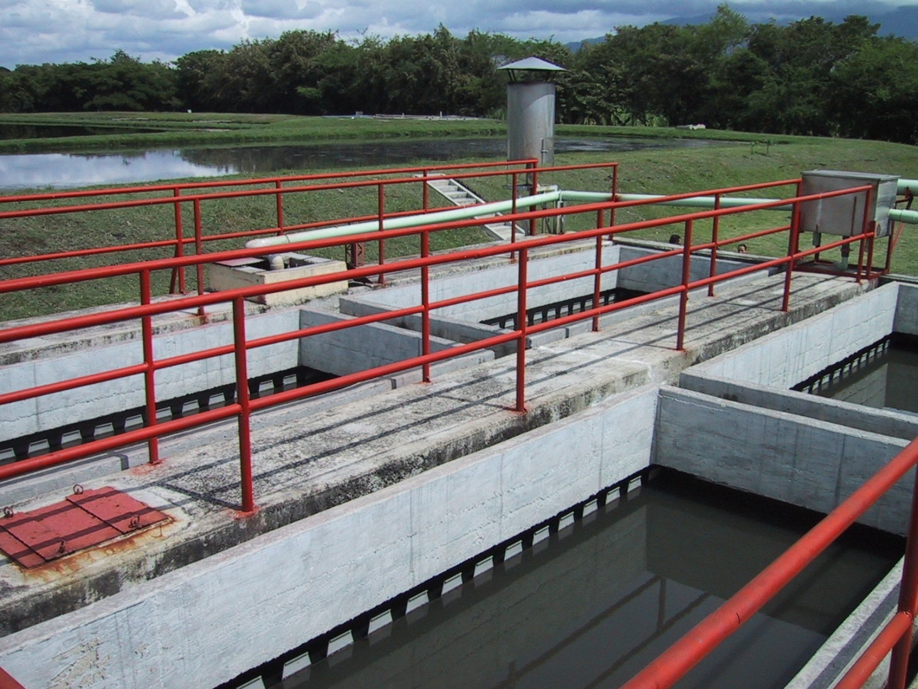
Waste water treatment

Slide 28
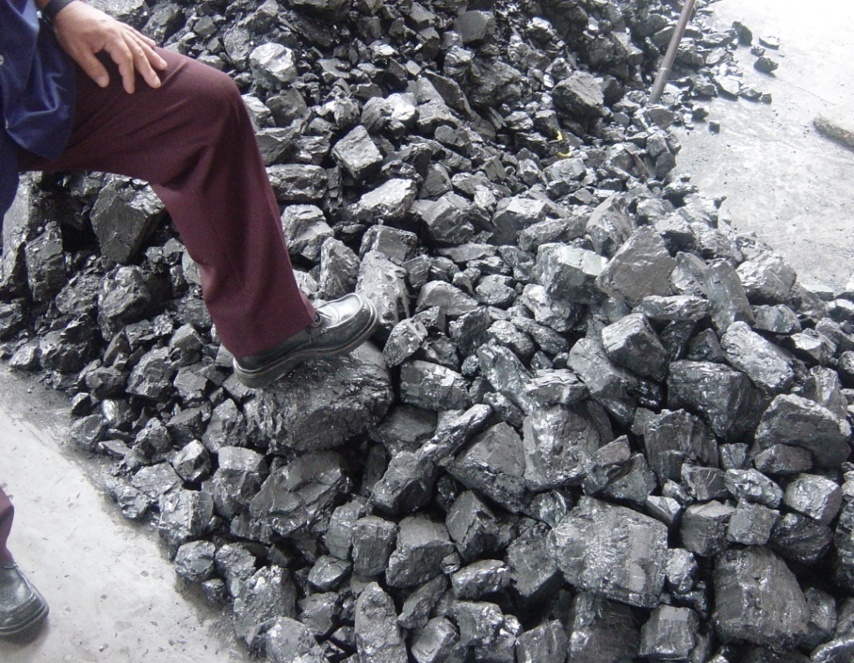
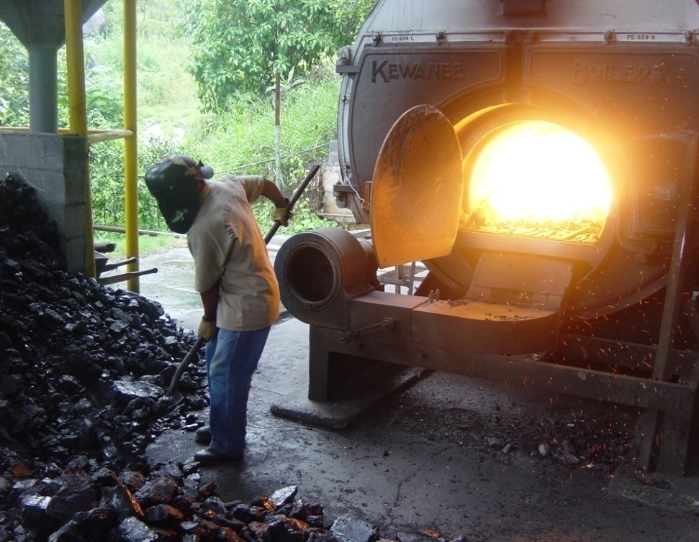
Boiler

Slide 29
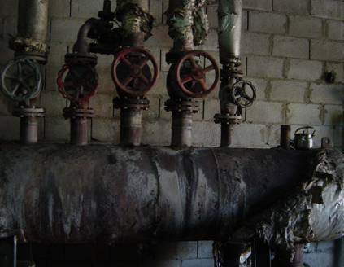
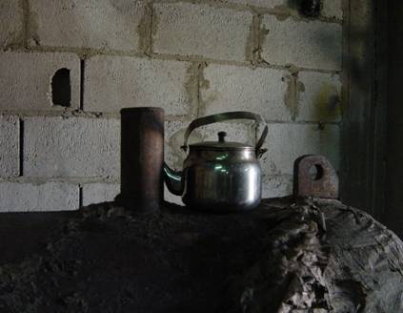
Steam manifold

Slide 30
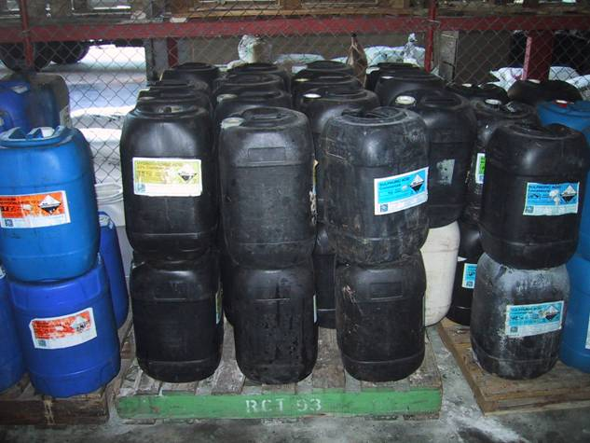
Storage of chemicals

Slide 31
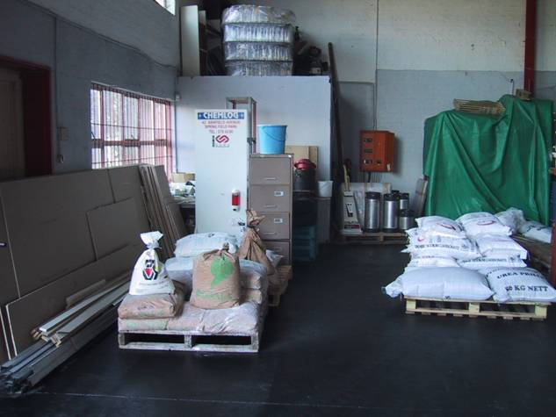

Slide 32
Food waste
25% of products is not consumed!

